Slide 1
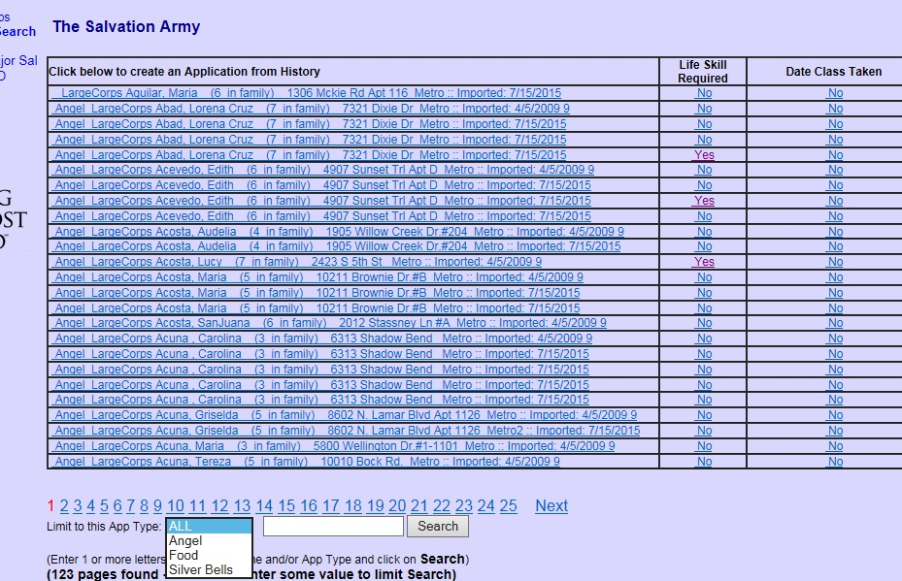
2015 – working with Angel History – Life Skill classes
On the AngelWeb main menu, open the link to Search History by HOH last Name
Note that you can limit the application type and search by HOH last name

Slide 2
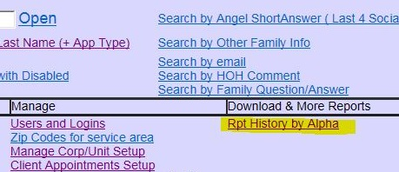
You can identify those applications in history that should take a Life Skills class by clicking on the column to toggle the value from No to Yes or back to No
You can also update the date the person completed the date by toggling the value from No to the current date.
You can also run a report and save the spreadsheet.

