Slide 1
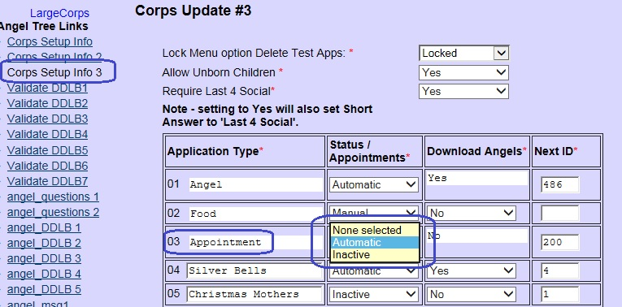
Working with Preregistration.
A Preregistration module has been added. Sites can allow clients to complete a portion of their application online, in advance of their interview with the Angel intake case worker.
1. Activate the Appointment type application on the site setup screen. Go to the Corps Setup Info 3 menu.
For type 03 – Appointment, change the status to Automatic. 2. At the bottom of this screen, create a secret code that clients will use on the preregistration URL to complete their prereg application.

Slide 2
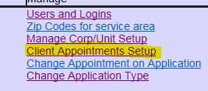
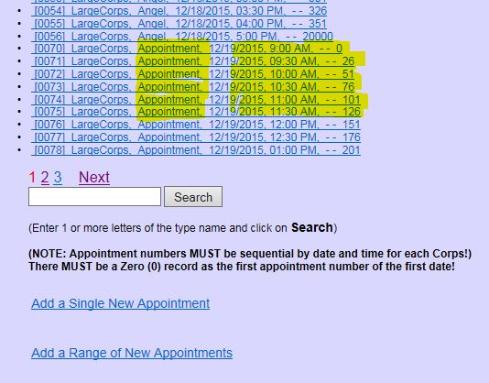
3. Create a range of Appointment type dates.
Like Angel appointments, Application appointments require a ‘0’ record on the starting date, A range of dates and number of appointments to assign, And an ending count like 20000 for the last time.

Slide 3
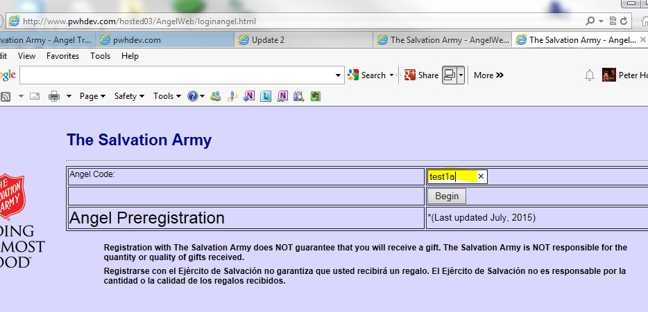
Clients should be given the URL for your site and the secret code so that their preregistration application will be assigned to your site. The URL is the same as your AngelWeb site, except it has loginangel.html at the end instead of your normal login.html
http://www.pwhdev.com/hosted03/AngelWeb/loginangel.html
Client will enter the Angel Code and proceed to complete the preregistration.

Slide 4
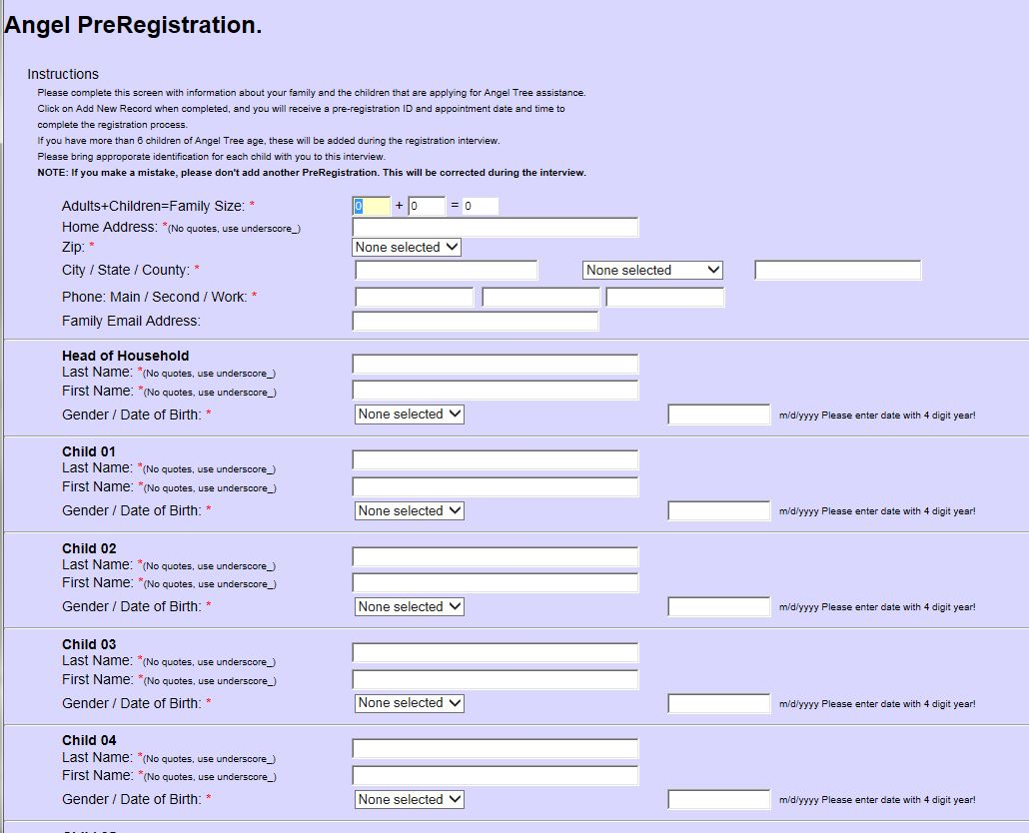
Client will complete the basic information for their family
When done, they will click on Add New Record to submit

Slide 5
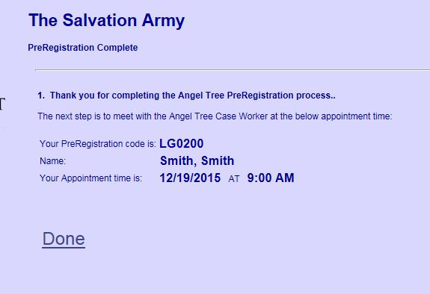
They will receive an appointment time for their follow-up visit with the Angel Intake case worker to complete their application for Angel assistance.

Slide 6
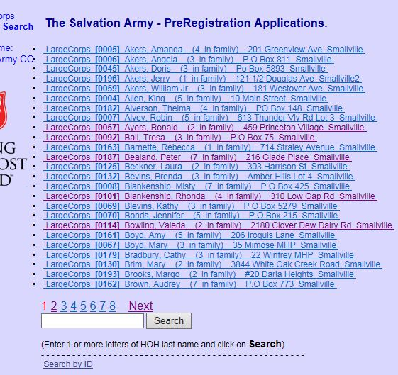
Application Time - using the preregistration detail.
From the main menu, select Search PreRegistration

Slide 7
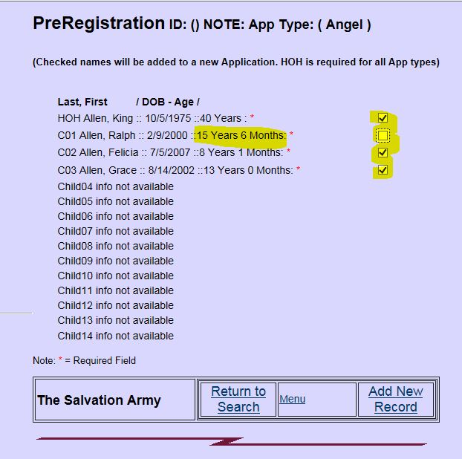
Locate the Preregistration application either by last name or Prereg ID.
If any of the children are too old, uncheck that child before clicking on Add New Record

Slide 8
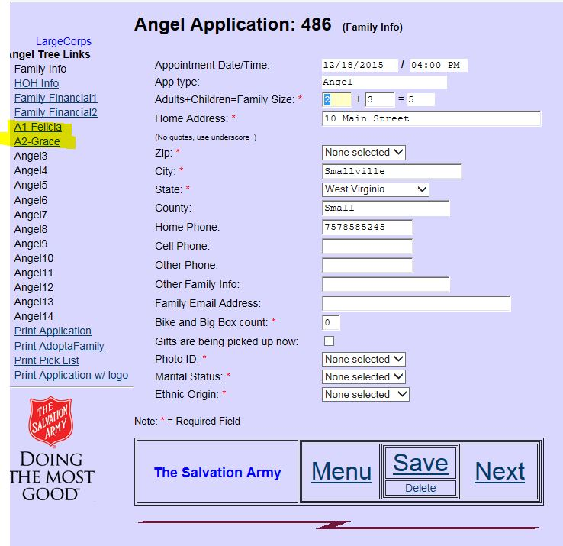
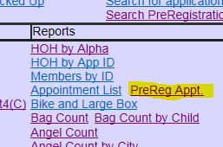
Complete each screen on the application as normal. Only those children selected will be imported.
A report is also available to download a spreadsheet of all preregistration applications available.

